Slide 1


Ethics Approver Tool
Kisha Wilson
Suffolk university law school

Slide 2


The scenario

Slide 3
What is the problem?
It’s an inefficient use of legal resources
Approval rules are inconsistently applied
It takes too long to receive an approval

Slide 4
Which stakeholders are most impacted?
In-house Attorneys
Employees seeking approval
Legal team support staff
Secondary stakeholders – outside employers, other departments looking to utilize attorney resources

Slide 5
Proposed solution
DOCASSEMBLE
Create a form that employees can use to seek approval by providing all of the required information
automatically generated an approval or declined memo
Notify the ethics mailbox of the decision
Technical specs
Docassemble
PDF produced
Housed in-house by technical team
Upkeep and maintenance by paralegal

Slide 6
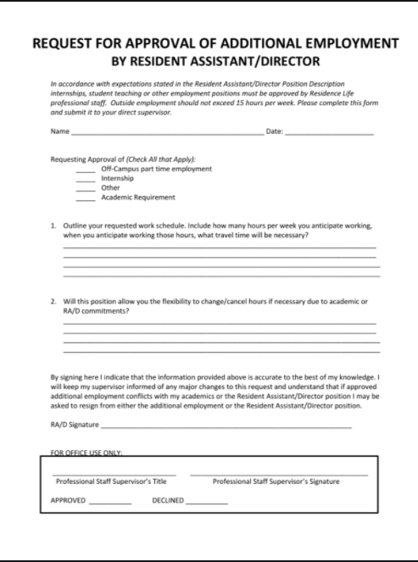
Example
Approval of an outside employment request

Slide 7
Questions?

Slide 8
Thank you!

